Slide 1
CS-GY 6083 B Principles of Database Systems
Final Project
WOW (World On Wheels) Car Rental Company
Team Members
Name: Jie Cheng NetID: jc12300
Name: Yunling Bai NetID: yb2473
Name: Pengfei Zheng NetID: pz2270

Slide 2
Business Case
WOW is a car rental company.
WOW has many office locations that maintain various classes of rental vehicles.
Each vehicle is identified by Make, Model, Year, VIN (Vehicle Identification Number), and License Plate number.
Each class has its own rental rate per day of the rental service and fees for over mileage.
WOW has customers of types of Individual or Corporate.
WOW provides discount coupons for both individual customers and corporate customers but only one type can be used at a time.
WOW can generate an invoice and customers can pay using multiple methods.

Slide 3
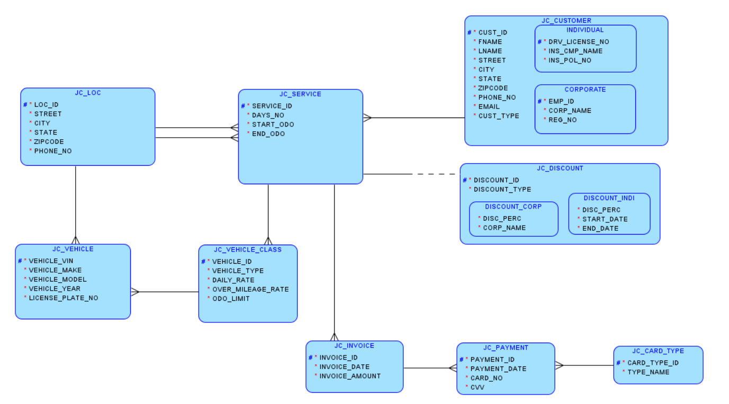
Logical Model

Slide 4
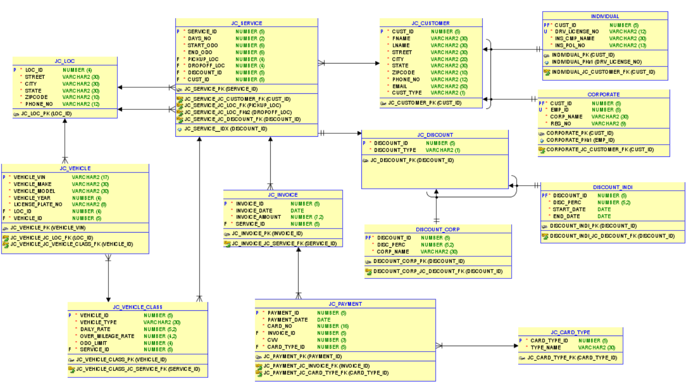
Relational Model

Slide 5
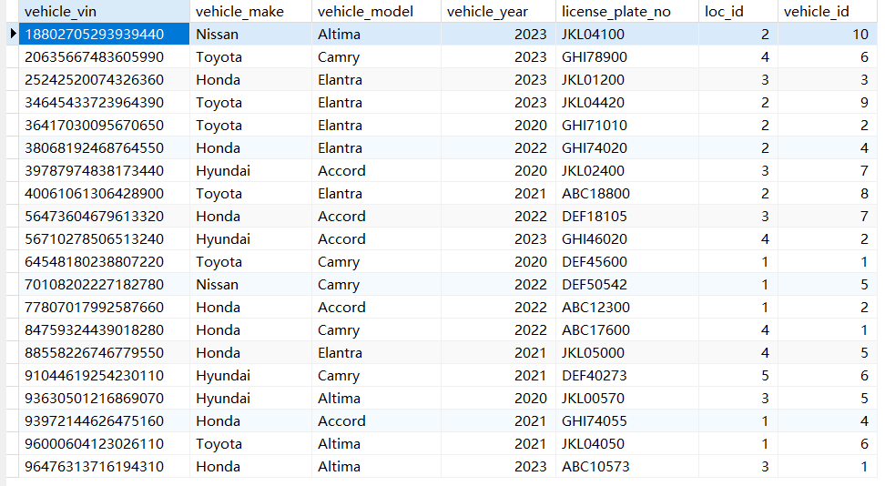
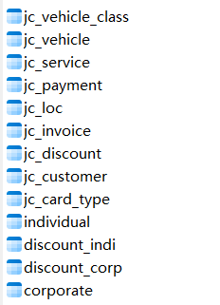
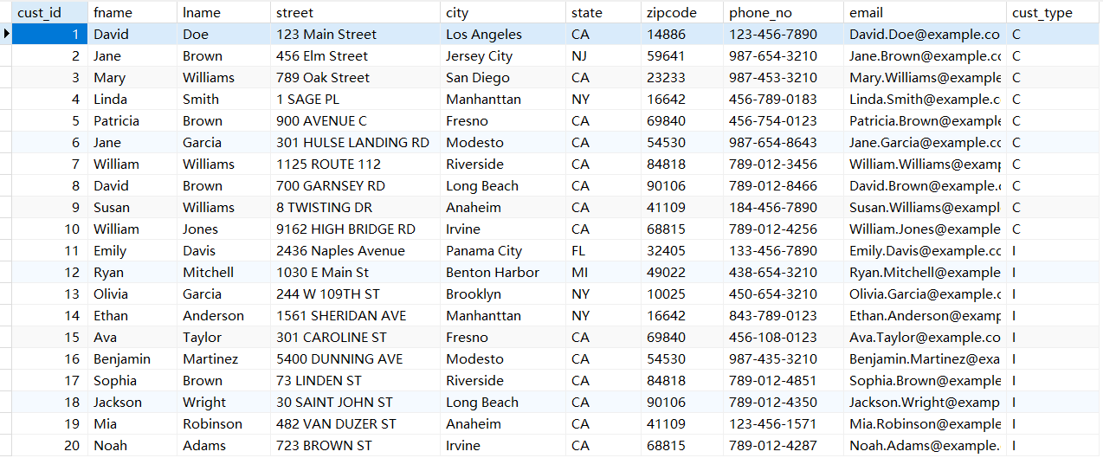
List of Tables

Slide 6
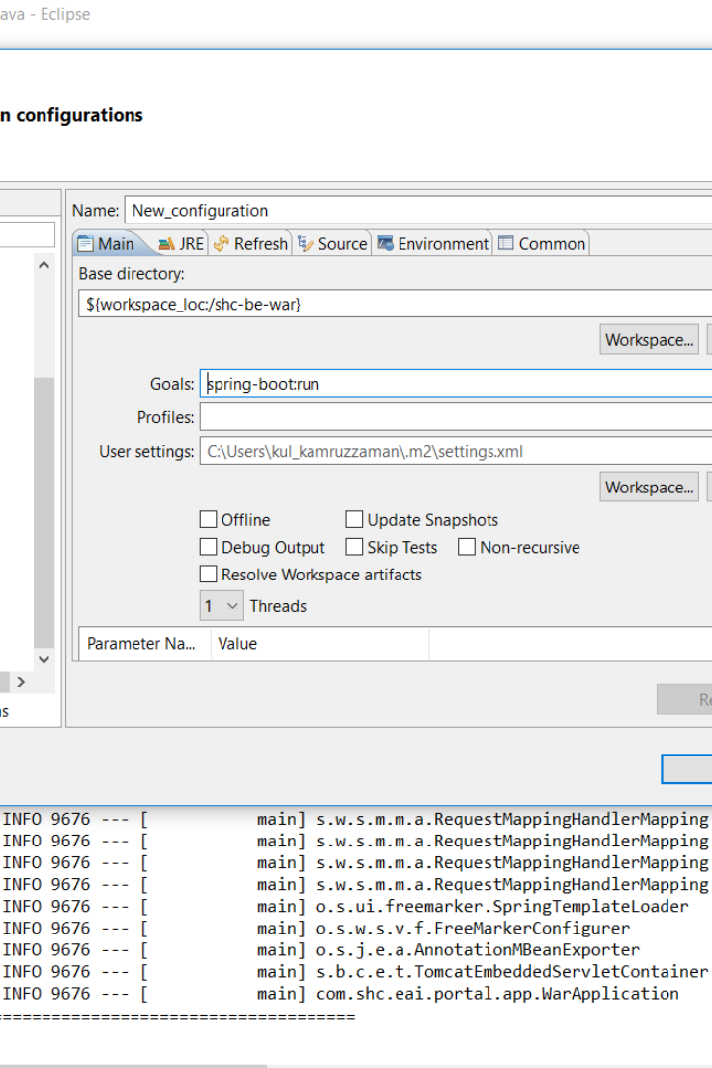
Backend Design
The WOW CAR RENTAL backend program is a Java Spring Boot application that provides the functionality for the car rental web application.
yb
by Yunling Bai

Slide 7
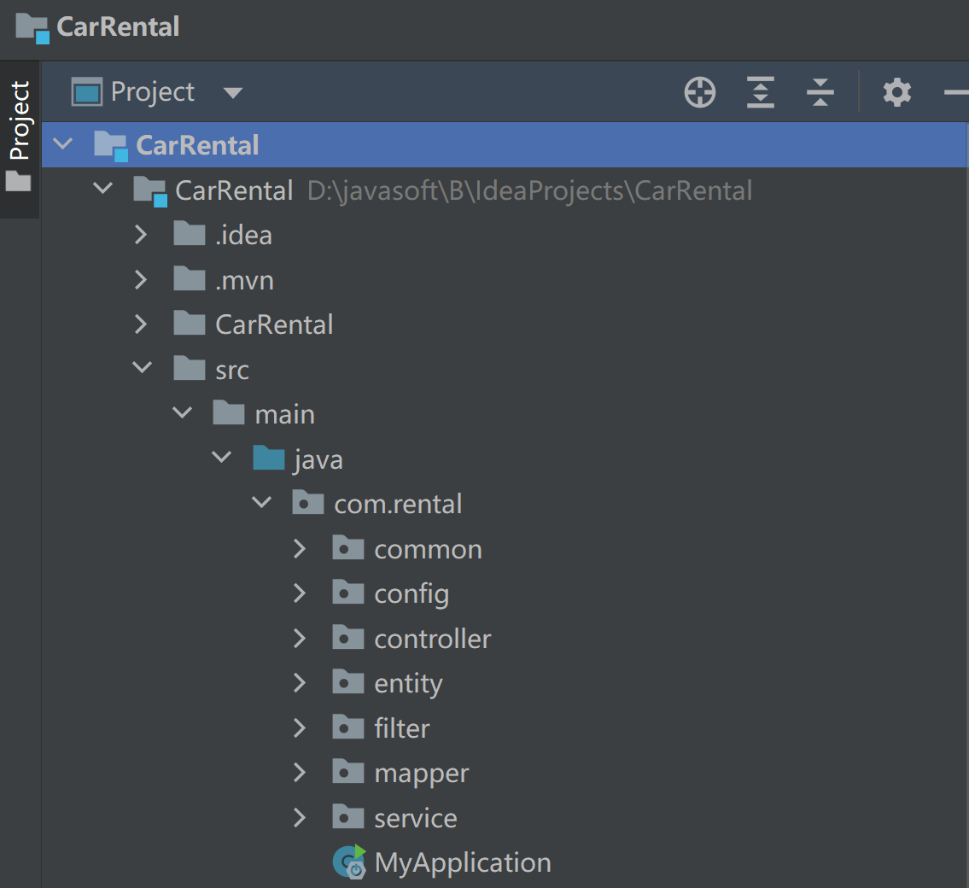
Architecture
Controller
Entity
The controller layer is responsible for handling HTTP requests from the web application. It prepares the response based on the service's output and sends it back to the web application.
This layer Represents the data models of the application, mapping to database tables and defining the structure of data objects.
Mapper
The mapper layer Uses MyBatis to simplify data access operations. It helps to translate data between objects and databases.
Service
The service layer implements the business logic of the application.

Slide 8
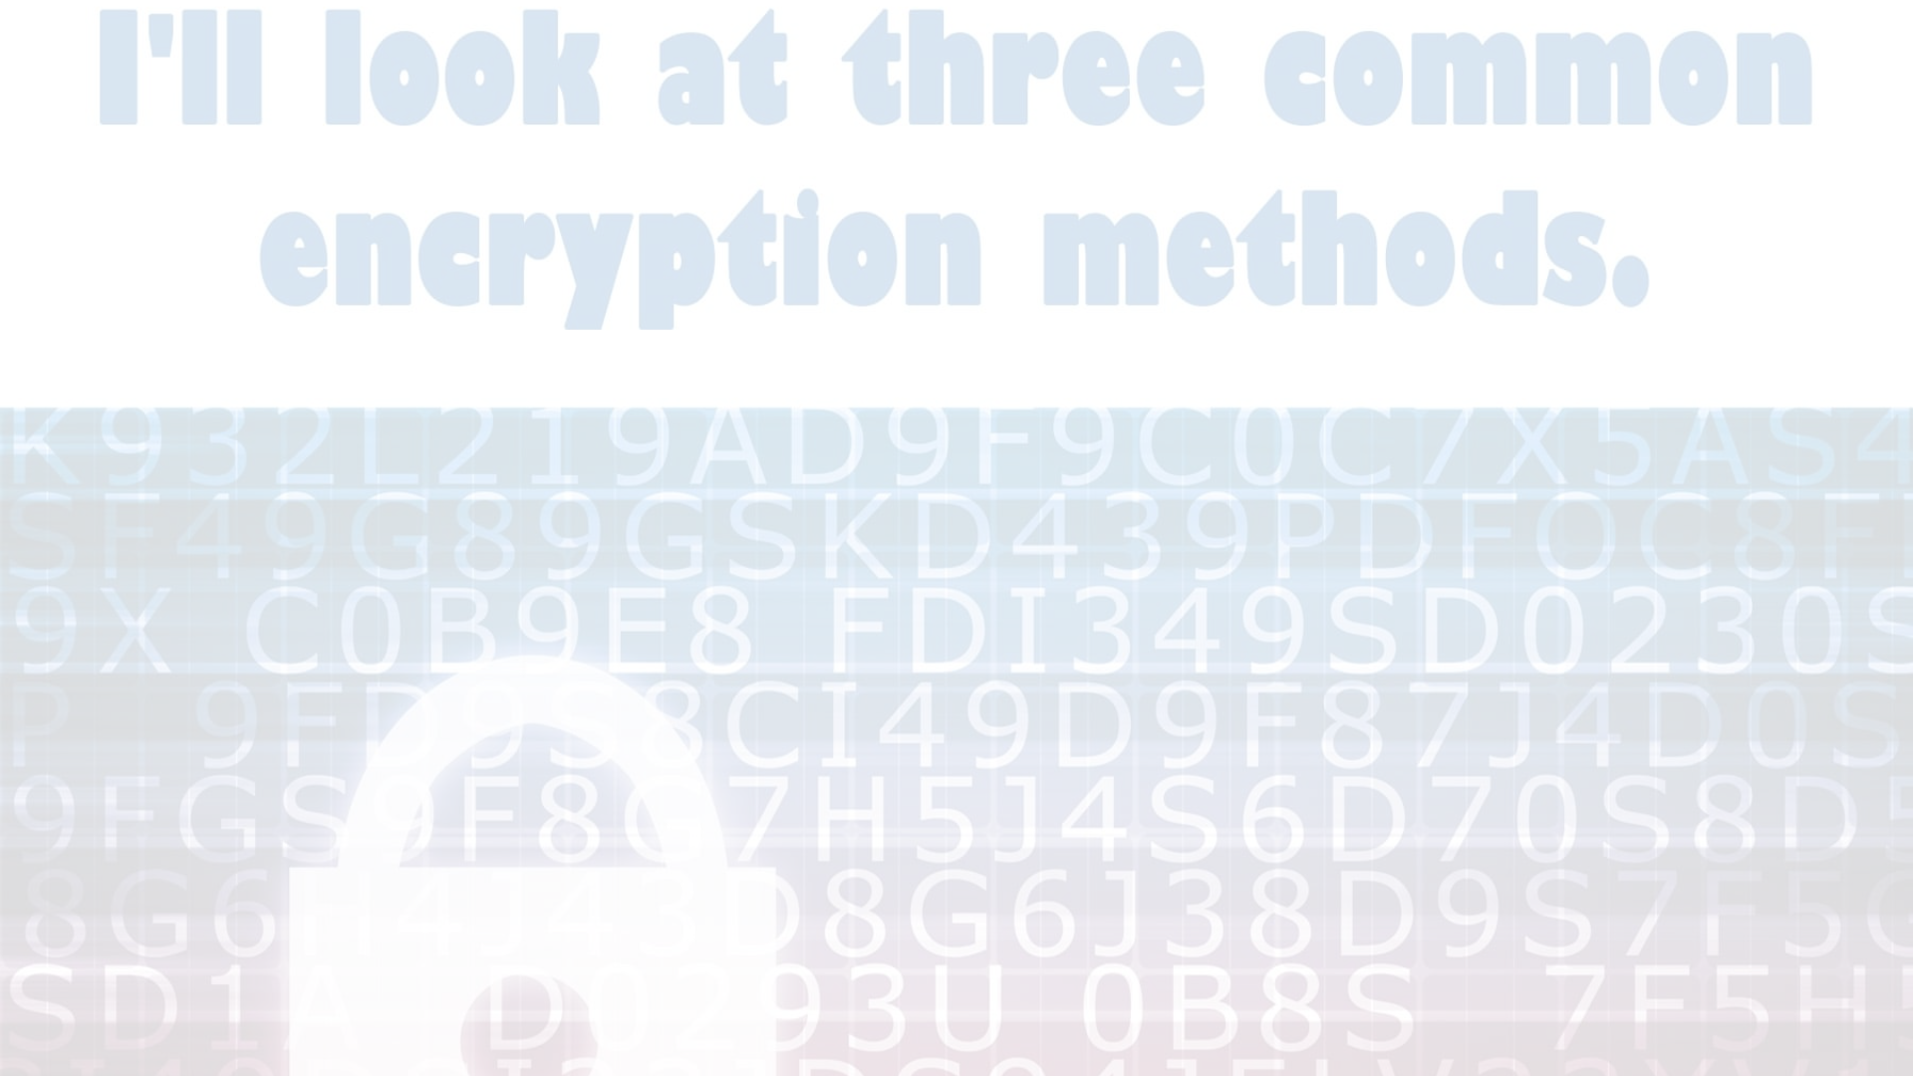
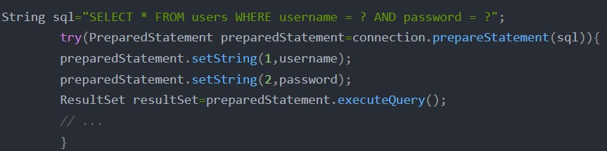
Features
Encryption Method
SHA-3 Algorithm
Employed for data integrity verification and secure password storage.
Preventing SQL injection
Pre-Prepared Statement
Used to prevent SQL injection attacks.

Slide 9

Security
1
Password encryption -SHA-3 Algorithm
Passwords are encrypted before they are stored in the database.
SHA-3, also known as Keccak, is a cryptographic hash function employed for data integrity verification and secure password storage.
2
SQL injection prevention
The pre-prepared statement method is used to prevent SQL injection attacks. This method allows the program to specify the SQL statement to be executed before the statement is actually executed, preventing attackers from injecting malicious SQL code into the statement.

